Slide 1
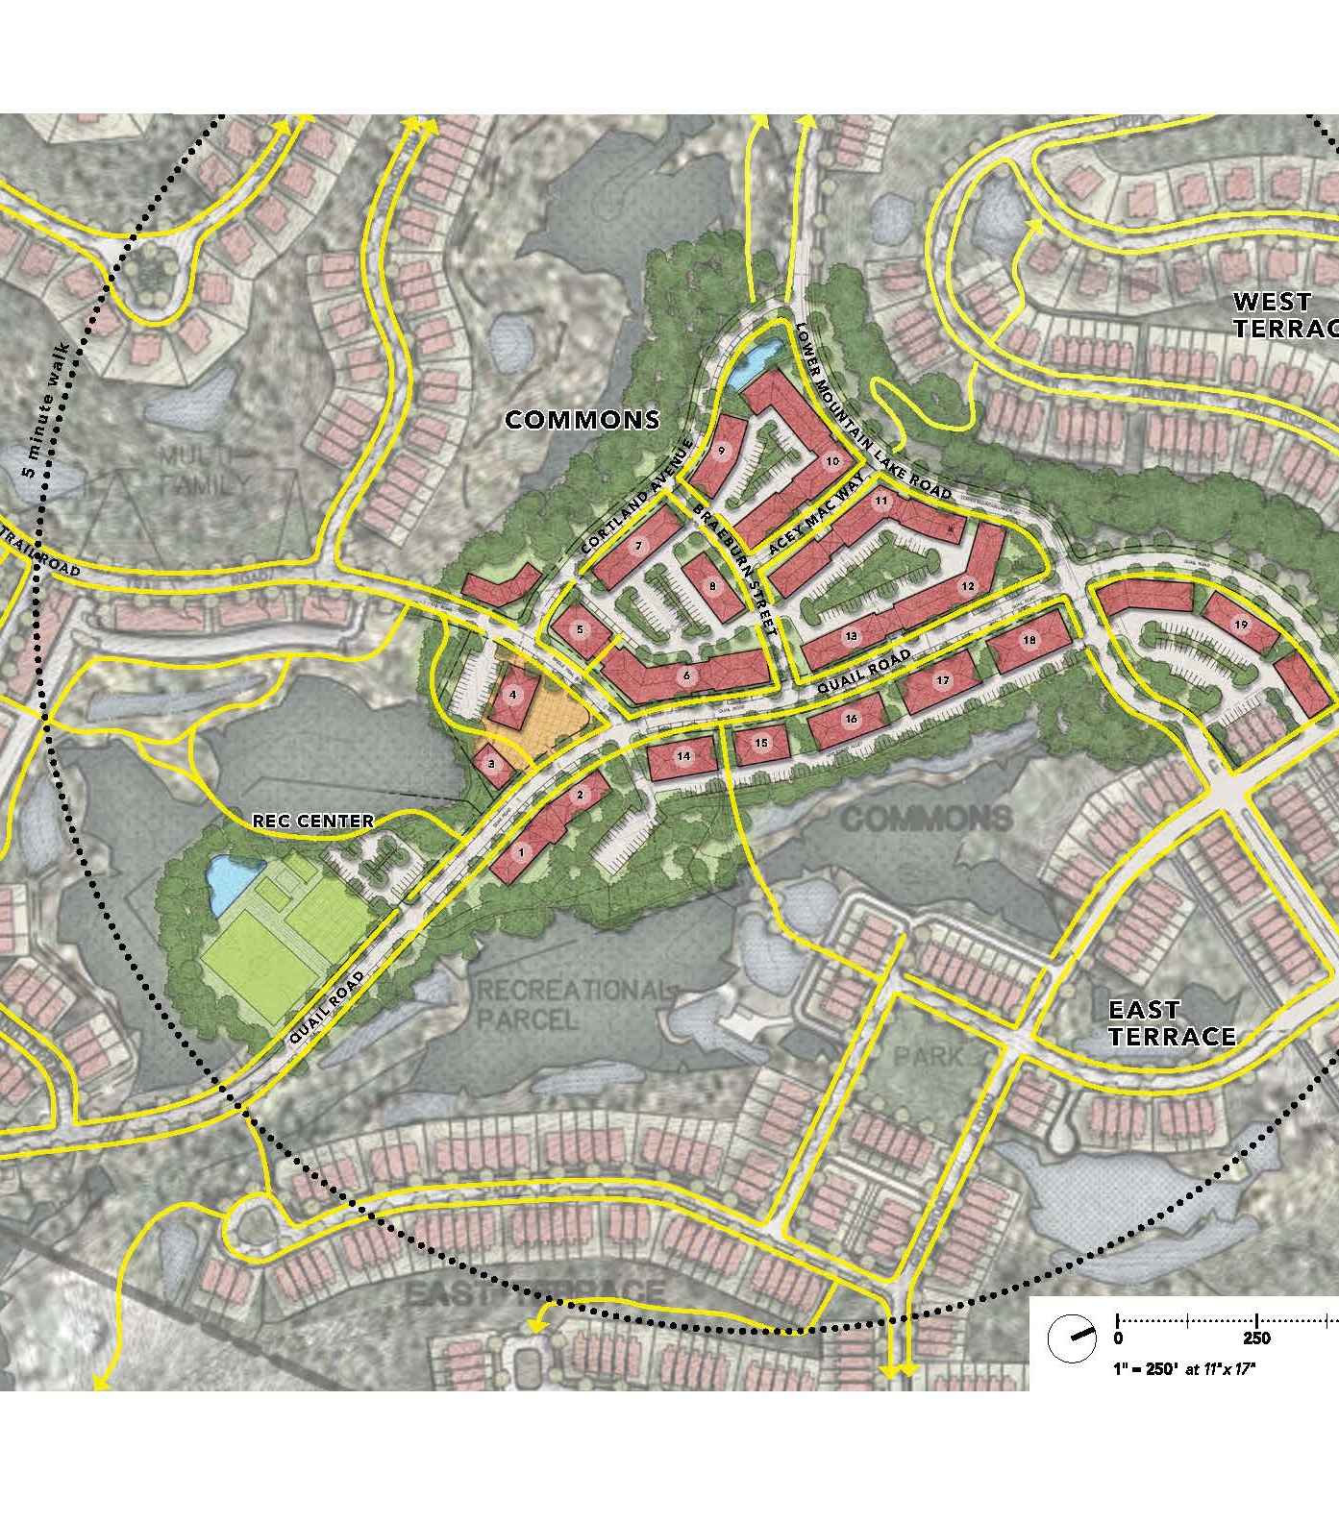
Tuxedo Farms Public Hearing
June 16, 2022

Slide 2
Project Approvals
DEIS/FEIS 1999-2003
SEQRA Findings 2004
SEIS/FSEIS 2009-2010
SEQRA Findings 2010
Special Permits 2004 & 2010
Amended Special Permit 2015
2015 Approved Plan
Notes:
Greg

Slide 3
Concept Plan: Overview
Notes:
Greg

Slide 4
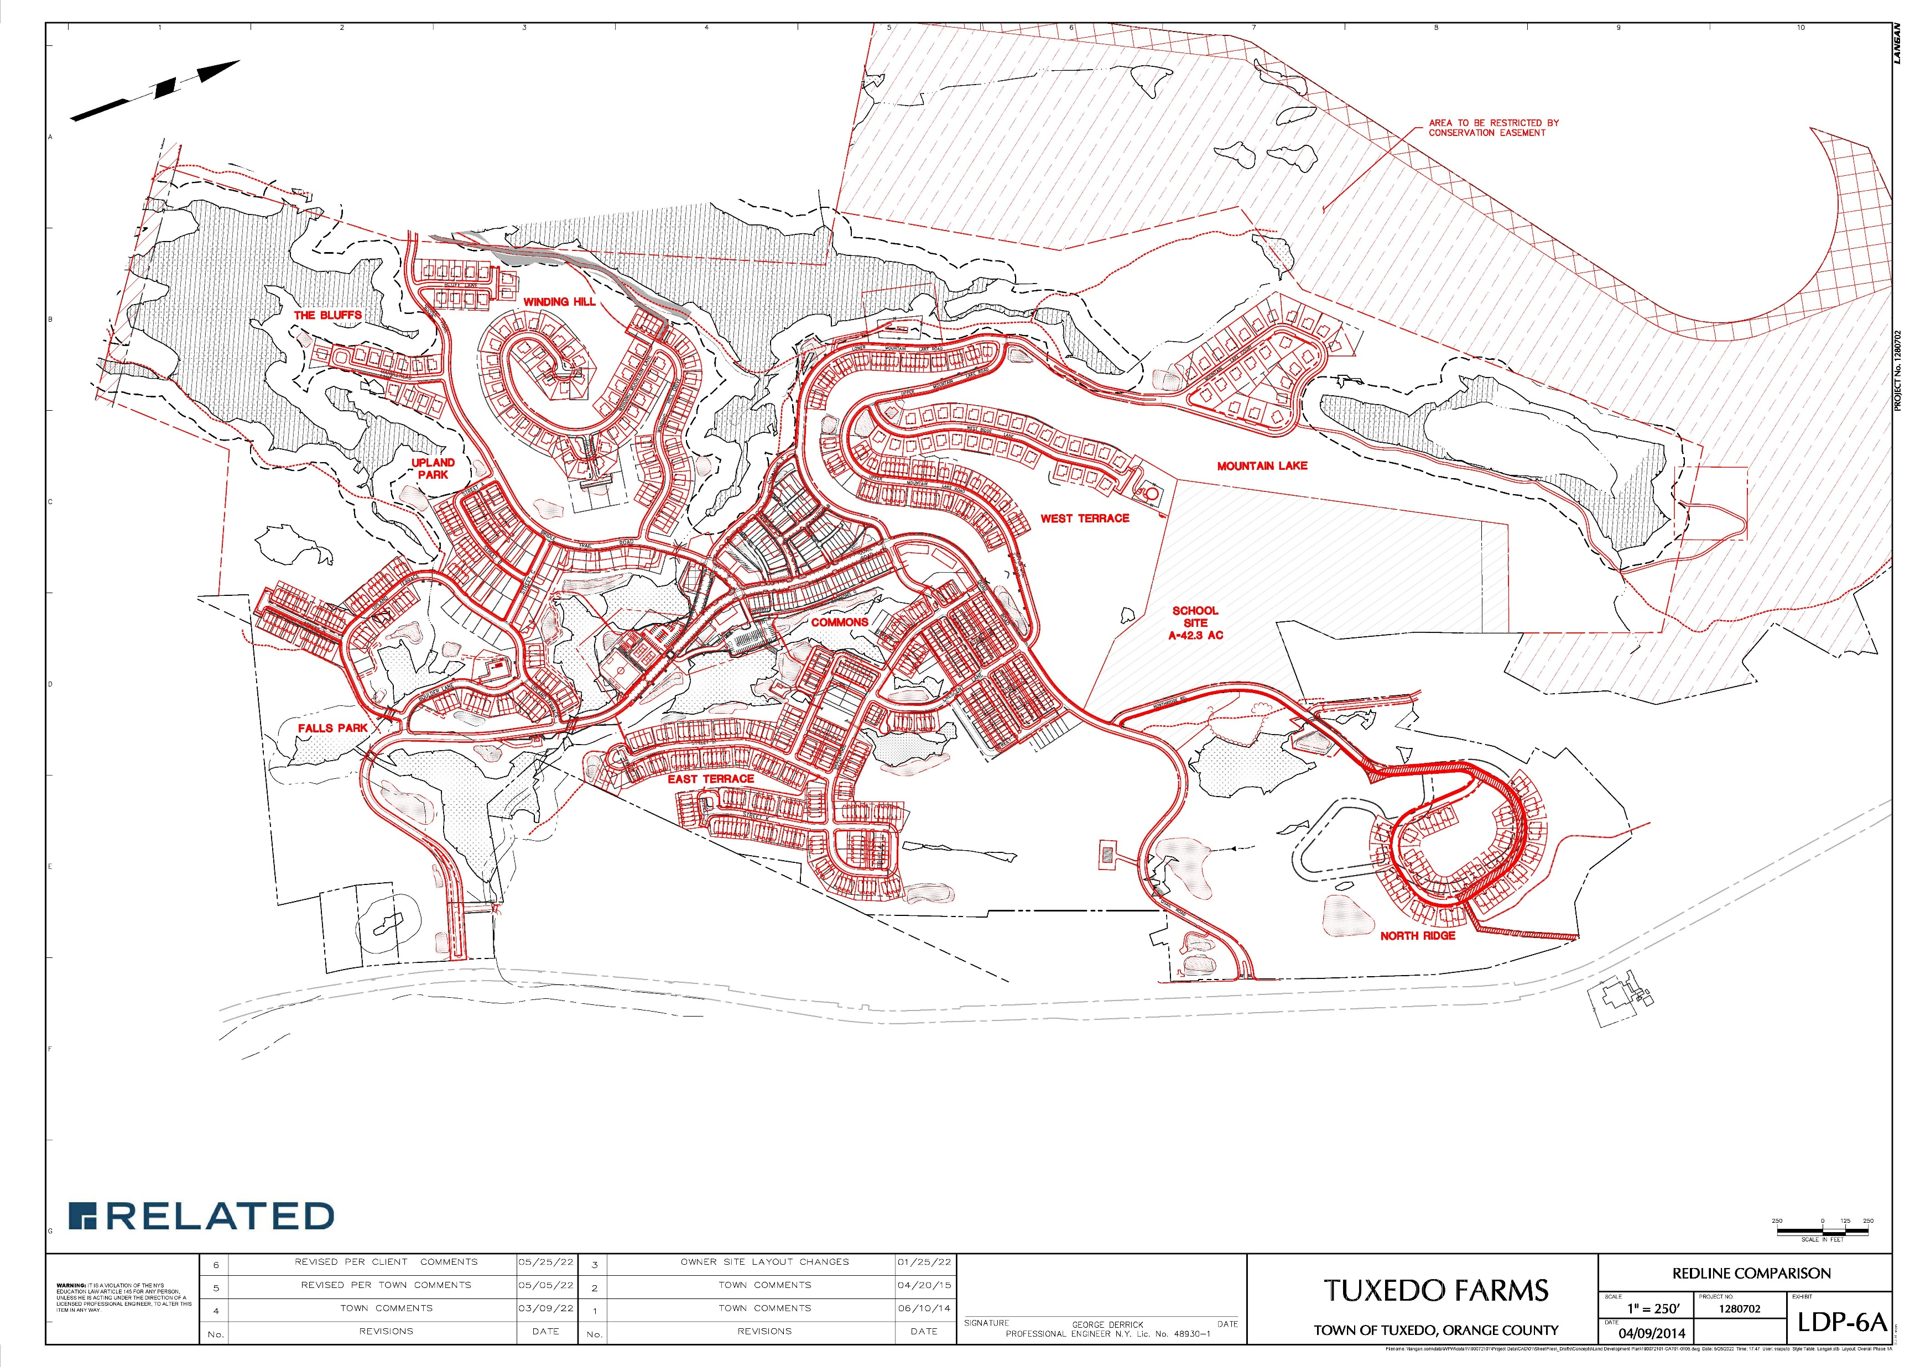
Project Changes: 2015 v. 2022
 | 2015 | 2022
Total units | 1,195 | 1,609
Total bedrooms | 3,324 | 3,514
Cap on non-age restricted bedrooms | 2,860 | 2,950
Minimum single-family/ attached single-family units | 764 | 413
Overall, limits of disturbance reduced from 443 to 380 acres
Maintains road network
Notes:
Mitch

Slide 5
2022 Amendments: Meet Market Demand for the “Missing Middle”
Between a single-family home and a mid-rise apartment
Greater housing choices
Similar living experience to a single-family home
Range of price points
Walkable communities
Designs are conceptual in nature and subject to change in accordance with the Design Guidelines
Notes:
Mitch

Slide 6
Concept Plan: Neighborhoods
Notes:
Mitch

Slide 7
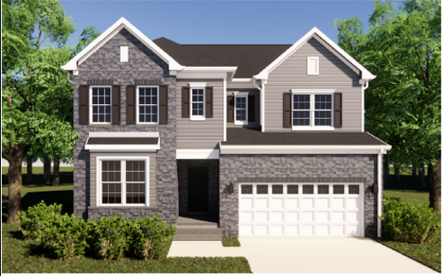
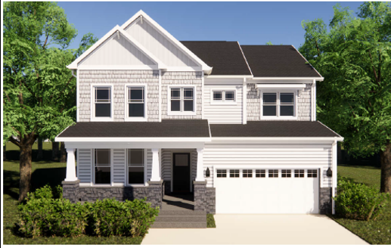
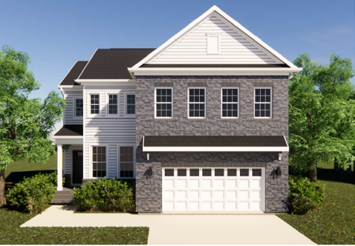
Single Family Homes
Designs are conceptual in nature and subject to change in accordance with the Design Guidelines
Notes:
Mitch

Slide 8
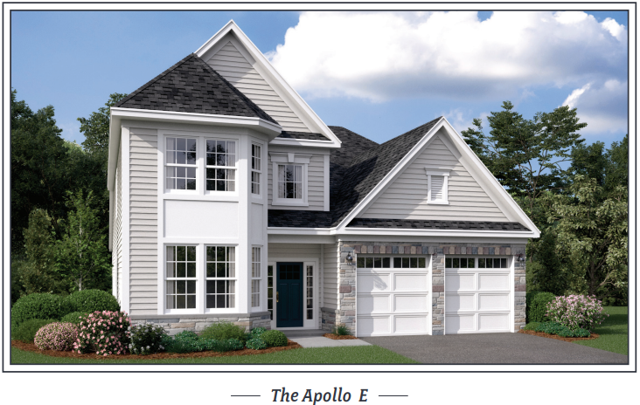
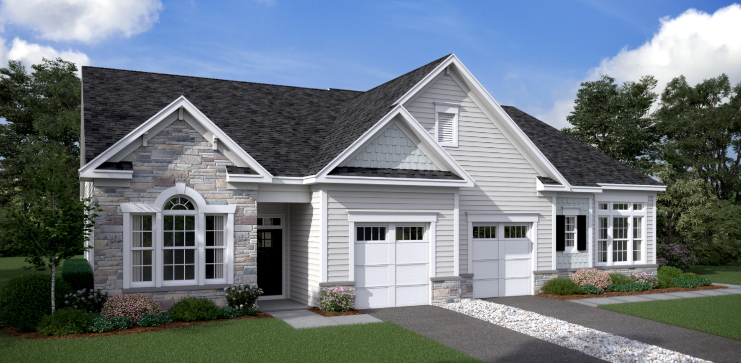
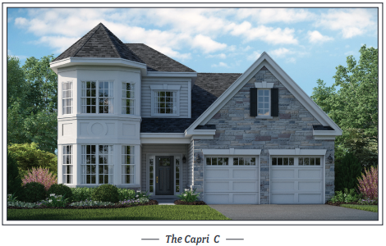
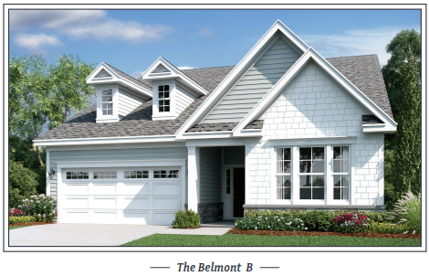
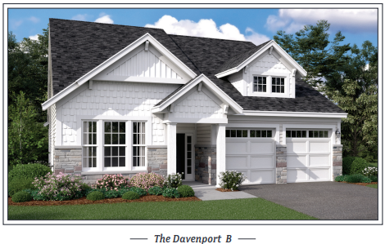
Active Adult Homes
Designs are conceptual in nature and subject to change in accordance with the Design Guidelines
Notes:
Mitch

Slide 9
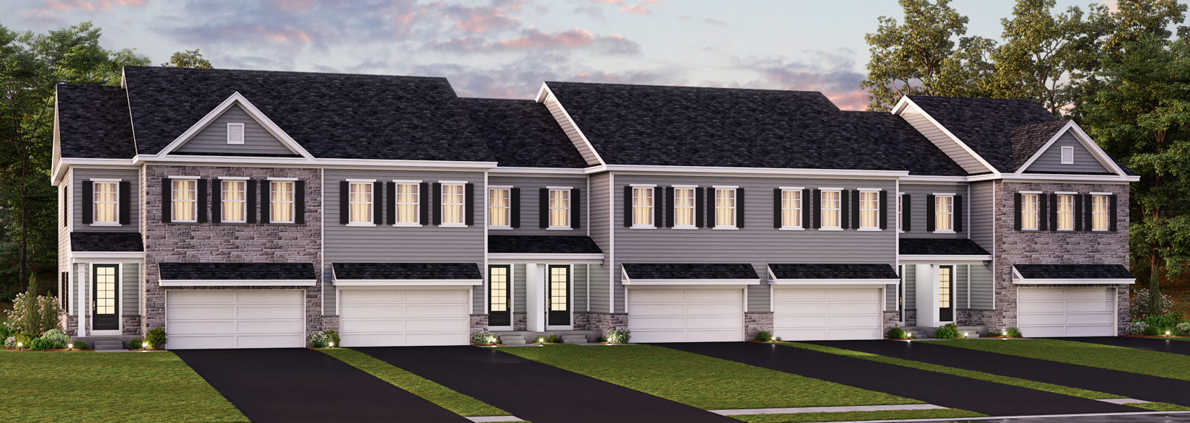
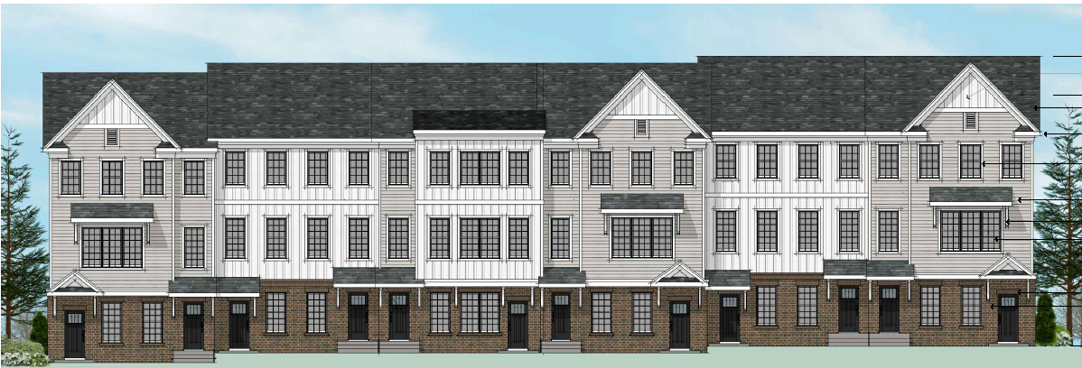
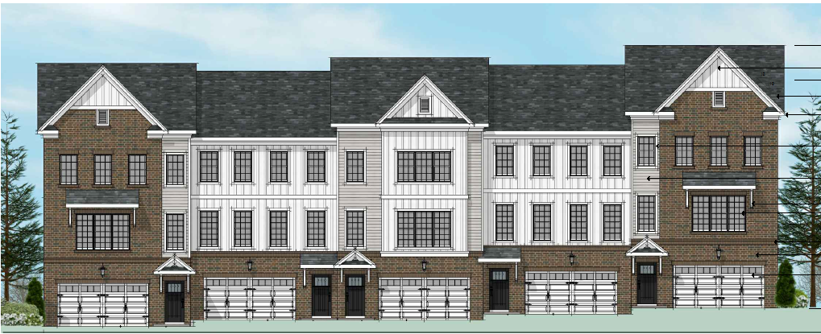
Townhomes/Stacked Townhomes
Designs are conceptual in nature and subject to change in accordance with the Design Guidelines
Notes:
Mitch

Slide 10
Commons Area
Notes:
Greg

Slide 11
Commons Area
Notes:
Greg

Slide 12
Commons Area
Notes:
Greg

Slide 13
Concept Plan: Neighborhoods
Notes:
Mitch

Slide 14
Design Standards Overview
Smart Code
Land uses
Lot sizes & types
Architectural Guidelines
Materials & colors
Building massing
Look-alike standards
Landscape Guidelines
Performance Standards
Engineering requirements
Notes:
Mitch

Slide 15
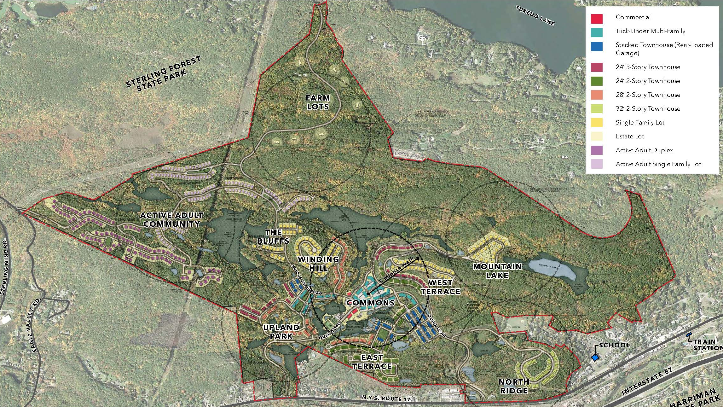
SEQRA Overview: Technical Memorandum
Project Description
Changes from prior approvals
Design Standards
Special Permit
Land Use, Zoning, and Public Policy
Economic and Fiscal Analysis
Cultural Resources
Visual Quality and Community Character
Geology, Soils, and Topography
Natural Resources
Hydrology and Stormwater Management
Water Supply
Sanitary Sewer
Solid Waste
Hazardous Materials
Traffic
Air Quality
Noise
Construction Impacts
Notes:
Ashley

Slide 16
SEQRA Conclusions
No significant adverse impacts
Fiscally positive
Disturbance reduced from 443 to 380 acres
Traffic mitigation measures
Stormwater Management
Sufficient water/sewer
Avoids impacts to threatened/endangered species
Notes:
Ashley

Slide 17
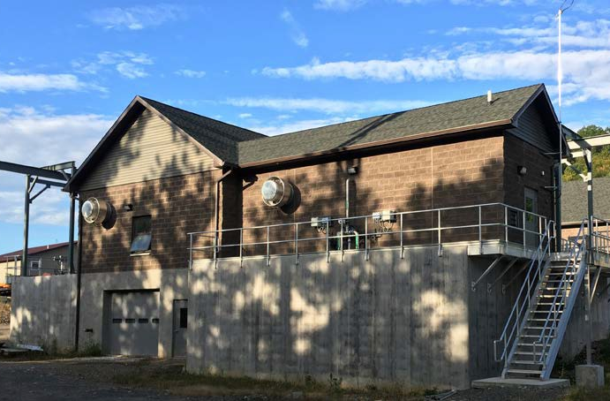
Project Benefits
Fiscally positive
Town ($1,953,165 net annual revenue)
School ($2,428,028 net annual revenue)
Secondary spending
New school age children
Commons
Library/Event Building
Trails/Recreation
Sewer Plant
700 acres of preserved open space transferred to Town
Renderings are conceptual in nature and subject to change in accordance with the Design Guidelines
Notes:
Greg

Slide 18
Next Steps
Continuation of Special Permit Public Hearing – 6/23
Planning Board referral meeting – 6/22
Orange County planning review
Local Law Public Hearing – 6/23
Close Hearing and Approve Special Permit – TBD
Sewer Plant – Summer
Planning Board Site Plan/Subdivision Review – Summer/Fall
Begin Construction – Nov/Dec 2022
Renderings are conceptual in nature and subject to change in accordance with the Design Guidelines
Notes:
Brad

