Slide 1
Six Year Road Plan For Town of Tuxedo, NY
Cornell Local Roads Program

Slide 2
What is the Cornell local Roads program?
The Cornell Local Roads Program was designed by a few Civil engineers who want to help local municipalities create an easier way for them to plan and keep track of road preservation and management. This program was created to help decide what should be done to each road based on condition, level of traffic, price and importance. This process used to be that the Highway Superintendent or another highway employee would look at the road and choose the appropriate repair or maintenance based on looks of the road, opinions and preferences. Now This process can be based on fact and data relating to the treatment of the road. The way this program works is by taking the road survey reports creating future plans for maintenance and repairs all done through the software known as Cornell Asset Management Program Road Surface or CAMP-RS.

Slide 3
What is a Rin Number?
Each road in Tuxedo was assigned a Road Inventory Number (RIN). These numbers sort roads by location and then alphabetically within each region. All roads in Eagle Valley are 1000 level with Alexander Drive being 1001. There are 7.806 miles of paved roads in Eagle Valley. All roads in the Hamlet (roads South of Warwick Brook Rd) are 2000 level with Antonelli Road being 2001. There are 5.234 miles of road in the Hamlet. All roads in Mountains (North of and including Warwick Brook Rd) are 3000 level with Alma Court being 3001. There are 12.734 miles of road in the Mountains. All together the Town of Tuxedo looks after 25.774 miles over 73 different roads.

Slide 4
Steps Taken for this project
Measure and record each road (also create RIN numbers)
Survey each road to determine the best approach
Research the best techniques for each road based off survey
Research cost to doing road work
Assign each road a repair type
Create a six year plan
Create report

Slide 5
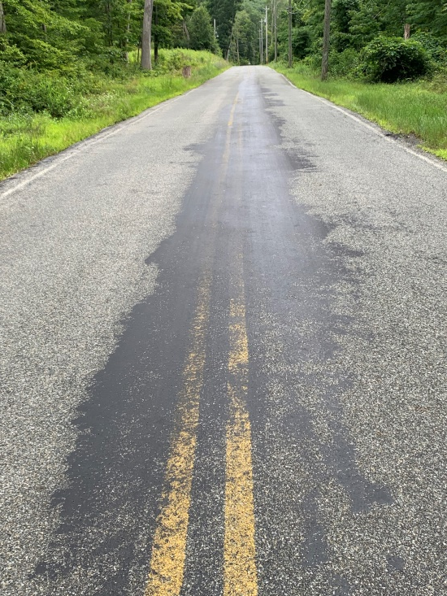
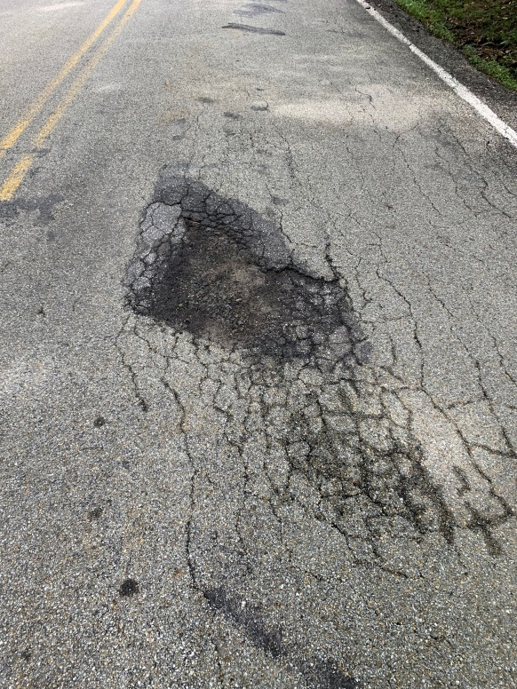
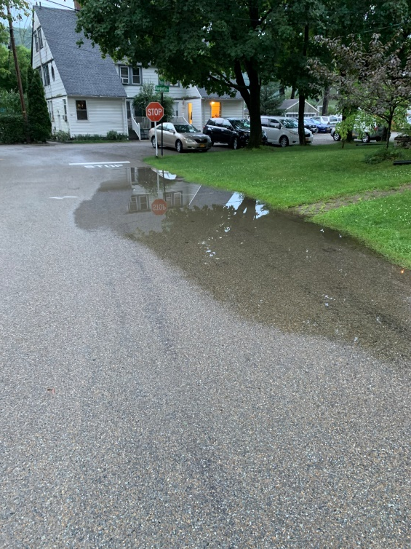
What we look for to determine the state of the roads.
Longitudinal/Transverse Cracking
Alligator cracking
Patching/Potholes
Rutting
Bleeding/Ralveling
Drainage
Roughness
Treatment condition
Edge Cracking

Slide 6
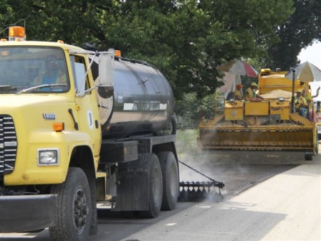
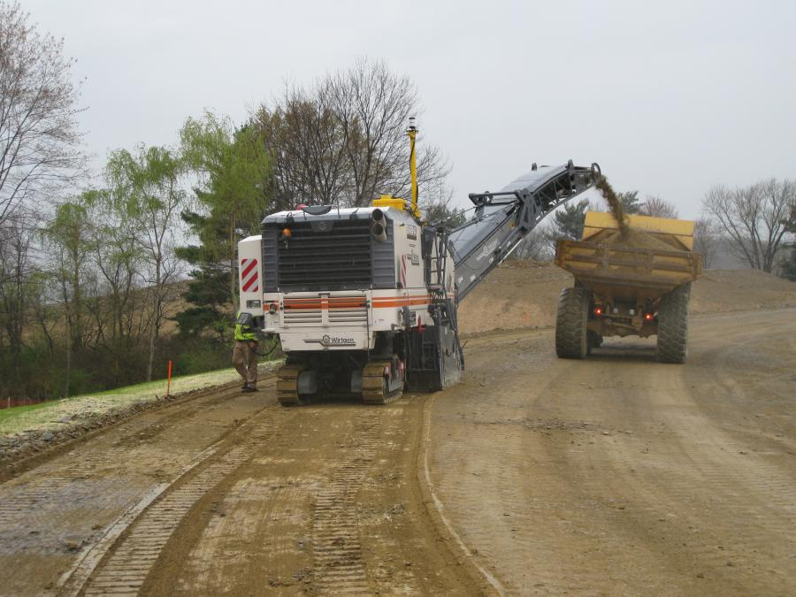
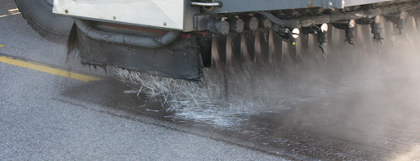
Road Techniques We plan on using
Chip Seal
Asphalt Overlay
Slurry Seal
Micro Mill and Nova Chip
Full Depth Reclamation
Double Chip Seal
Fiberrmat

Slide 7
How Roads are chosen
Each Road in tuxedo was given three different numbers; Importance number, Traffic Number and a Pavement Condition Index (PCI) number. The Importance number and the traffic number were rated on a 1-5 scale (1 being Low and 5 being High). The importance number was determined by how important the road is to the town. The traffic number was determined by the amount of cars/trucks that traveled the road a day. The PCI number was rated from 1-100 (1 being low and 100 being high). A roads PCI number is determined by the quality of the road. Once all three numbers are added we receive the roads priority value for the road which help us determine which roads need help the most and which we could leave be.

Slide 8
Conclusion
This project has brought to light the route that needs to be taken with the roads in Tuxedo. Under the current budgeting given to me by Highway Superintendent Robert Dollbaum of $325,000 (125,000$ from permanent repairs and General repairs 200,000$ and with a 5% increase per year to keep up with increasing prices) we are able to get most roads done in a six year period. We were hoping to have all roads done in five years but due to the current budget six is the fastest it could be done. With an increase in the Permanent road repair Budget this would expedite our road program to bring all roads to a long term serviceable condition in a shorter period of time.

Slide 9
1st Year - 2022
3004-Benjamin Meadow Road – Micro Mill and Nova Chip
3011-Fawn Hill Road – Micro Mill and Nova Chip
3022-Sylvan Way – Micro Mill and Nova Chip
2030-Tobin Way – Slurry Seal
2026-Temple Drive – Slurry Seal
2027-Tornado Drive – Slurry Seal

Slide 10
2nd year - 2023
3005-Bramertown Road – Micro Mill and Nova Chip
3012-Hall Drive – 1.5” Asphalt Overlay
3001-Alma Court – Chip Seal
3021-Susan Court – Chip Seal
3013-Helmstown Court – Chip Seal

Slide 11
3rd year - 2024
3019-Spice Bush Road – Micro Mill and Nova Chip
3009-Deerpath Road – Micro Mill and Nova Chip
3014-High Hill Road –Micro Mill and Nova Chip
3008-Cross Ridge – Micro Mill and Nova Chip
1008-Eagle Valley Road – Micro Mill and Nova Chip

Slide 12
4th Year - 2025
3025-Warwick Brook Road – Double Chip Seal
3002-Arden Road – Chip seal
3003-Arden Station Road – Chip Seal
3010-East Mombasha – Chip Seal
3006-Brandy Hill – Chip Seal
3016-Katrina Court – Chip Seal
3017-Nolans Way – Chip Seal
3018-Railroad Avenue – Chip Seal
3020-Spring Street – Full Depth Reclamation
3007-Clinton Road – Chip Seal
3024-Valerie Road – Chip Seal
3026-Woods Road – Chip seal
2023-Stevens Lane – Chip Seal
2024-Stone ridge – Chip Seal

Slide 13
5th Year - 2026
2011-Library Road – Chip Seal
2012-Mountain Road – Chip seal
2013-Nursery Road – Chip seal
2014-Oak Place – Chip seal
2015-Park Avenue – Chip seal
2019-Schoolhouse Lane – Chip seal
2020-Schoolhouse Road – Chip Seal
2021-Southside Place – Chip seal
2022-Sparten Place – Chip seal
2025-Store Road – Chip seal
2028-Tuxedo Road – Chip seal
2029-Van Zandt – Chip Seal
3010-East Mombasha – Double Chip Seal
1013-Maple Brook Road – Chip seal
2007-East Village Road – Fibermat
2008-Grove Drive – Fibermat
2006-East Place – Fibermat
2003-Center Street – Fibermat
2018-River Road – Fibermat
2005-Contractors Road – Full Depth Reclamation
2001-Antonelli Road – Chip Seal
2002-Augusta Place – Chip Seal
2004-Circle Drive – Chip Seal
2009-Hillside Avenue – Chip seal
2010-Hospital Hill – Chip Seal

Slide 14
6th Year - 2027
1016-Southgate road – Micro Mill and Nova Chip
1004-Buttonwood Road – Chip Seal
1006-Chestnut Court – Chip Seal
1002-Ash Court – Chip Seal
1017-Summit Brook – Chip Seal
1011-Hillary Court – Chip Seal
1001-Alexander Road – Chip Seal
1003-Babcock Hill – Chip Seal
1007-Constitution Court – Chip Seal
1010-Heritage Court – Chip Seal
1012-Juniper Terrace – Chip Seal
1014-Salierno Drive – Chip Seal
1018-Table Rock Road – Chip Seal

